Slide 1
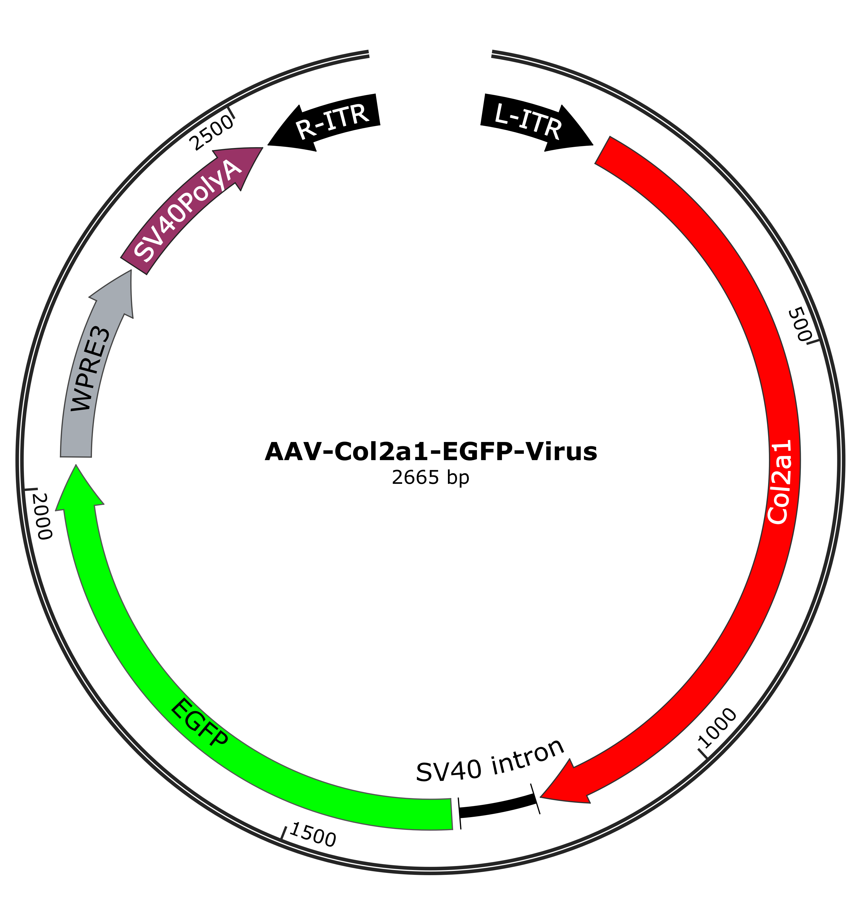
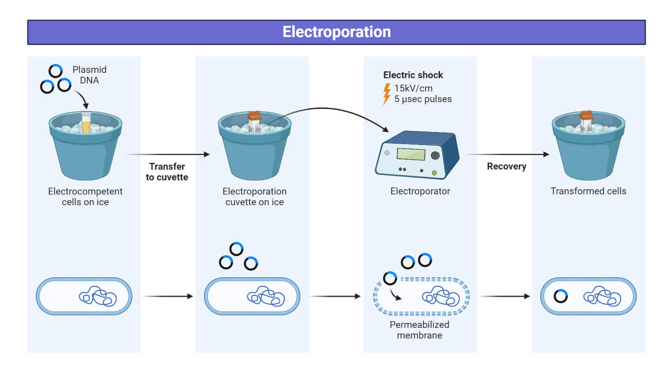
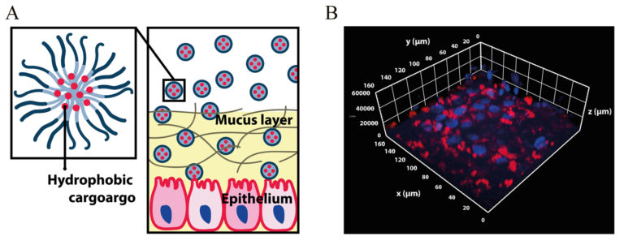
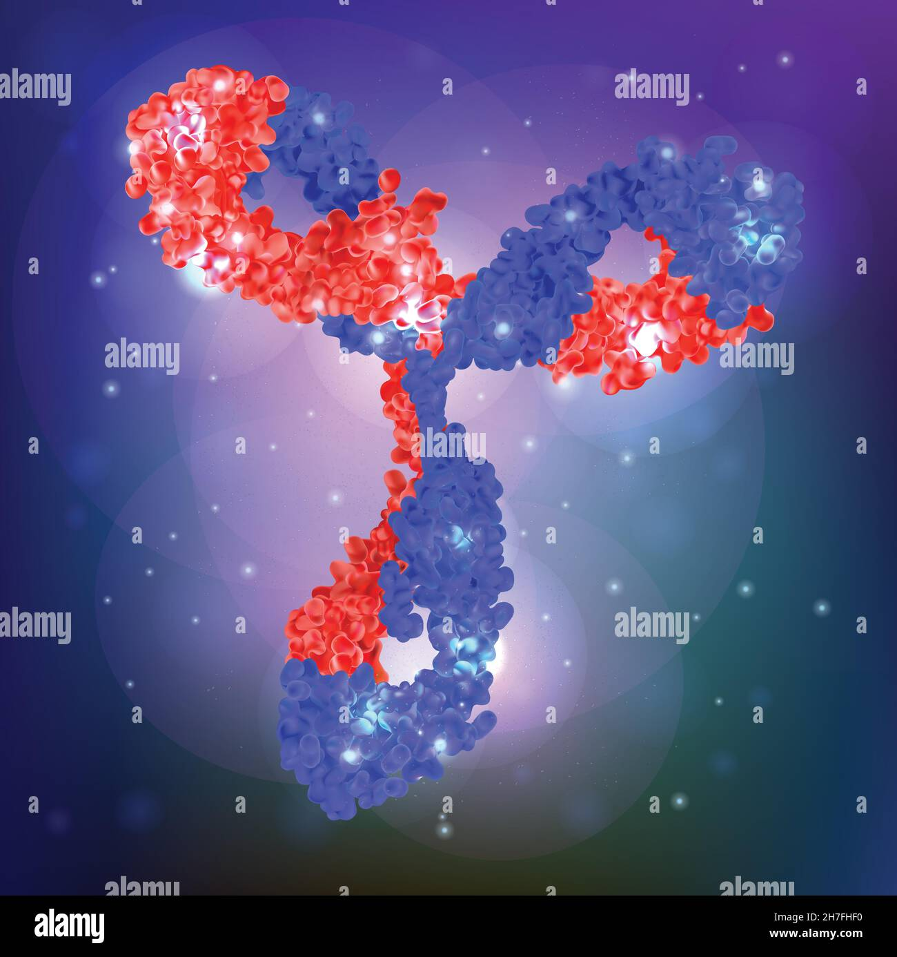
Delivery Modalities: Getting Editors to Cells
Works best for: In vivo editing in tissues with suitable serotypes (e.g., eye, muscle, CNS subtypes)
Pros: Strong tropism and transduction; single-dose potential; long-term expression (for some applications)
Constraints: Capsid size limits (~4.7 kb) constrain editor payloads; pre-existing immunity/re-dosing challenges; potential for vector integration and liver toxicity at high doses
Notables: EDIT-101 (AAV5) for LCA10; Dual-AAV or compact nucleases (SaCas9) mitigate payload limits
Works best for: Autologous/allogeneic cell therapies (HSPCs, T cells, NK cells)
Pros: Transient RNP delivery—minimal off-target window; high editing rates and multiplex capability; no viral DNA integration
Constraints: Manufacturing complexity and cost; conditioning regimens for reinfusion (e.g., myeloablation); logistics of cell collection and release testing
Notables: Exa-cel/CASGEVY (BCL11A enhancer edit) for SCD/TDT; multiplex-edited allogeneic CAR-T programs
Works best for: In vivo delivery to liver; expanding to extrahepatic targets via ligand/capsid engineering
Pros: Transient expression reduces prolonged exposure risk; manufacturable at scale; modular chemistry; amenable to repeat dosing in some contexts
Constraints: Hepatocyte bias limits tropism; infusion-related reactions; dose ceiling considerations; endosomal escape efficiency is a key bottleneck
Notables: NTLA-2001 (Cas9 mRNA + gRNA LNP) for ATTR; VERVE-101 (ABE mRNA + gRNA LNP) for PCSK9
Works best for: Emerging systemic/extracellular targets; specialized tissues
Pros: Potential for targeted delivery with ligands/antibodies; avoids viral immunity concerns
Constraints: Lower transfection efficiency historically; formulation stability and biodistribution challenges
Notables: Virus-like particles (VLPs); polymeric/ionizable lipid hybrids; physical methods (hydrodynamic, microinjection for ocular)

